Slide 1
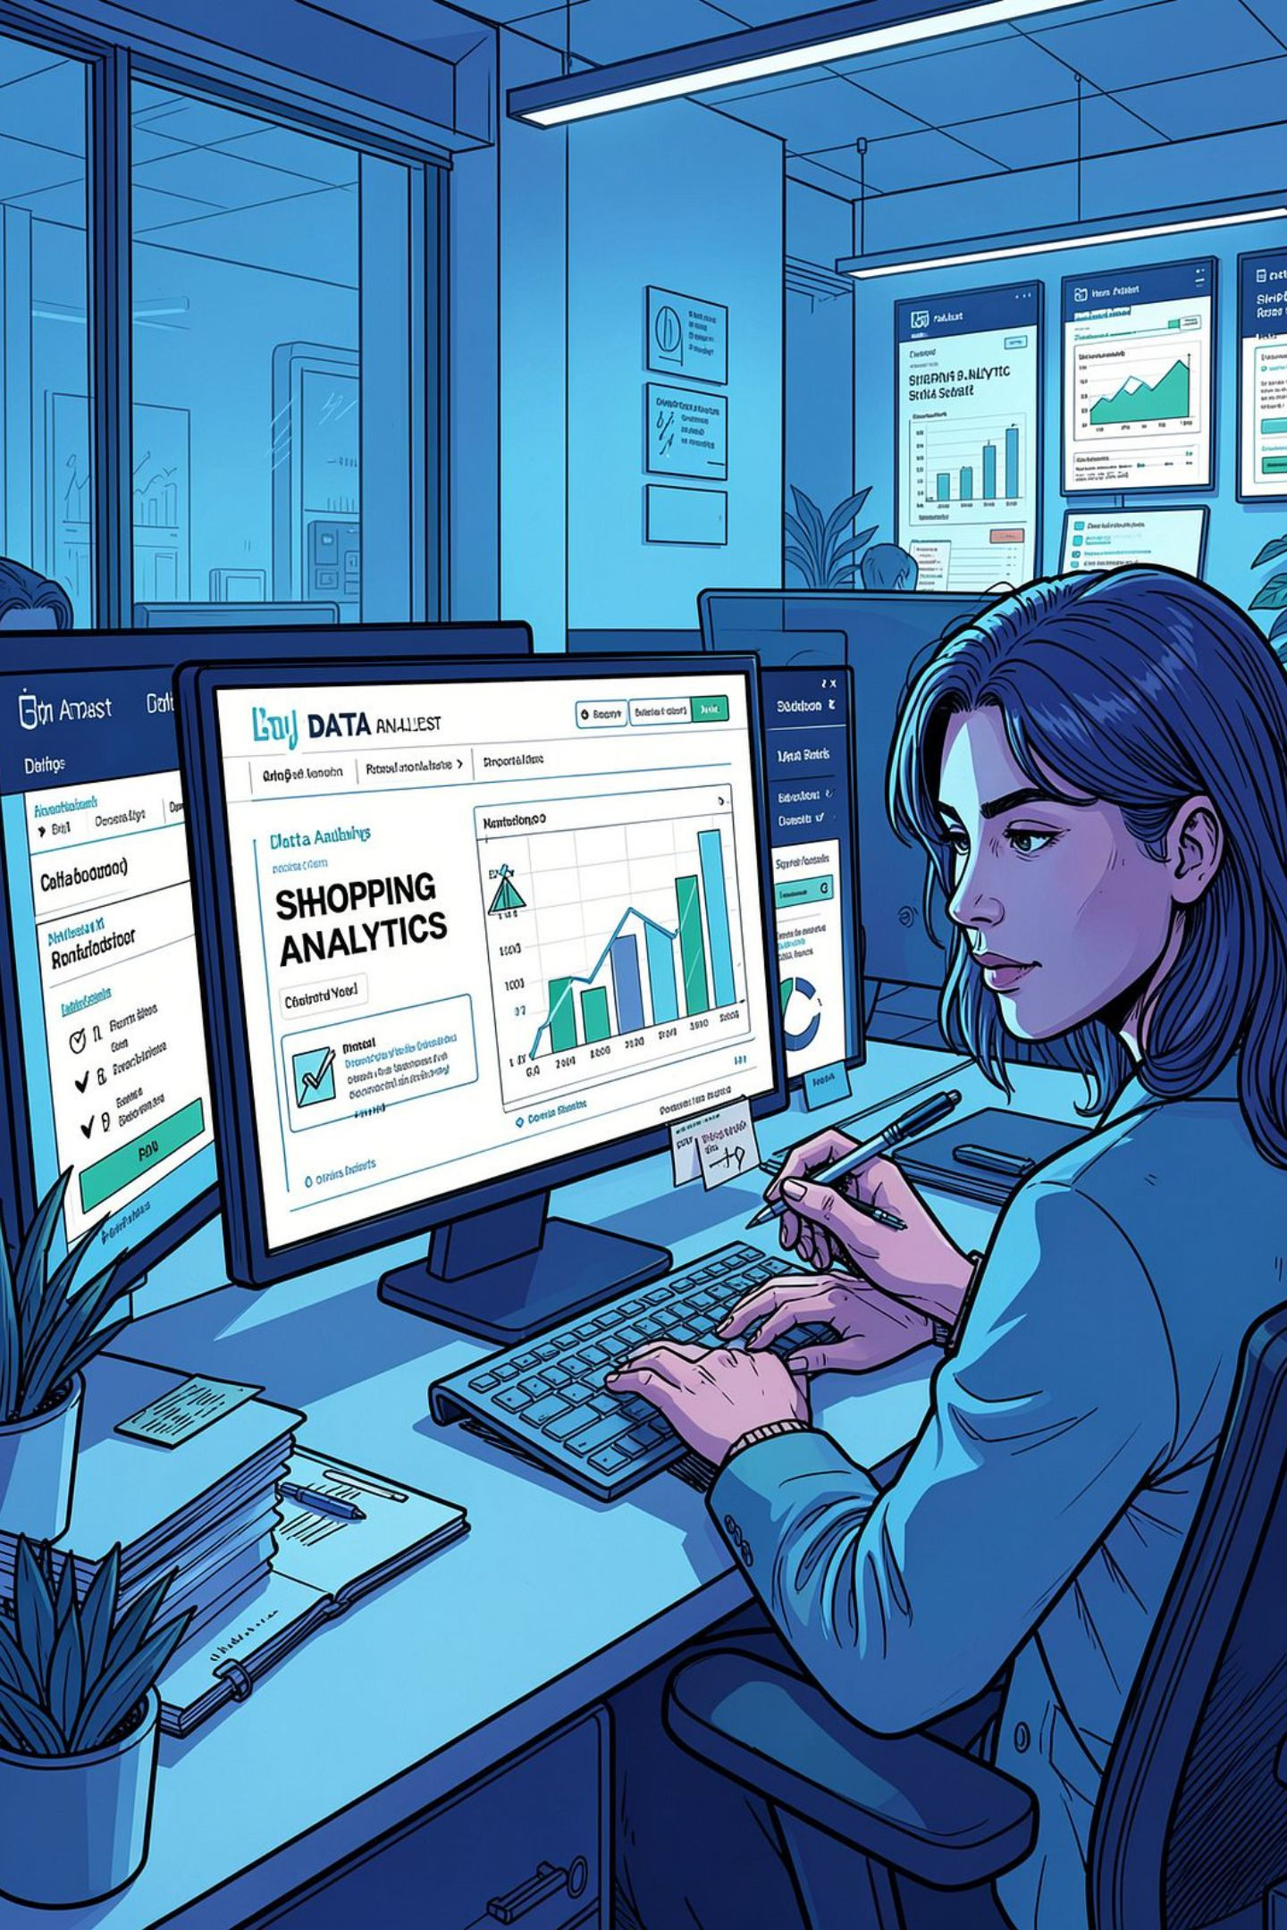
Customer Shopping Behavior Analysis
Uncovering insights from 3,900 transactions across product categories — spending patterns, customer segments, and subscription behavior to guide strategic decisions.

Slide 2
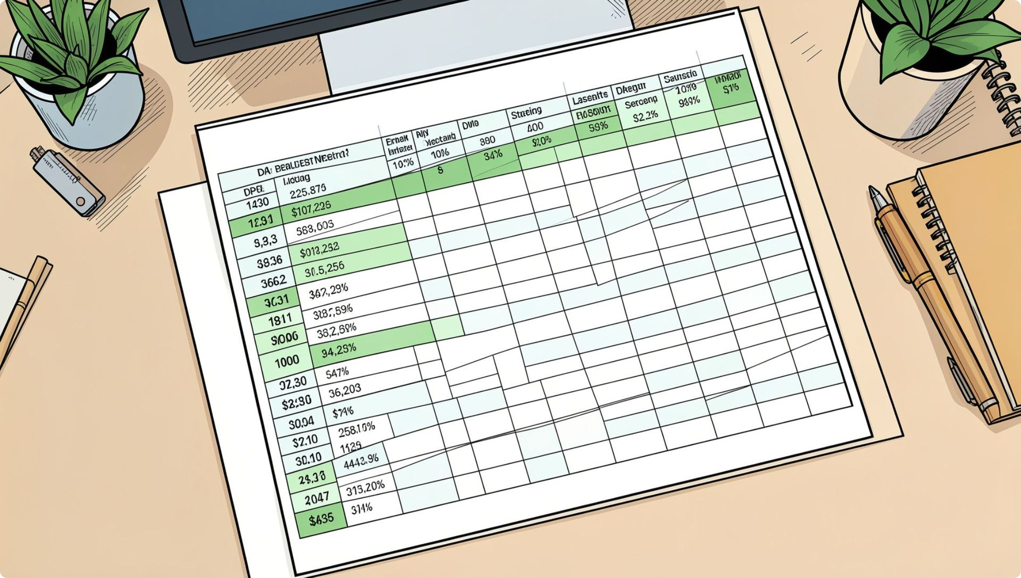
Dataset at a Glance
Key features include customer demographics (Age, Gender, Location, Subscription Status), purchase details (Item, Category, Amount, Season), and shopping behavior (Discount, Frequency, Review Rating, Shipping Type).
3,900 Rows
18 Columns
37 Missing Values
Transactional records across all product categories
Demographics, purchases, and shopping behavior
Only in Review Rating — imputed by category median

Slide 3
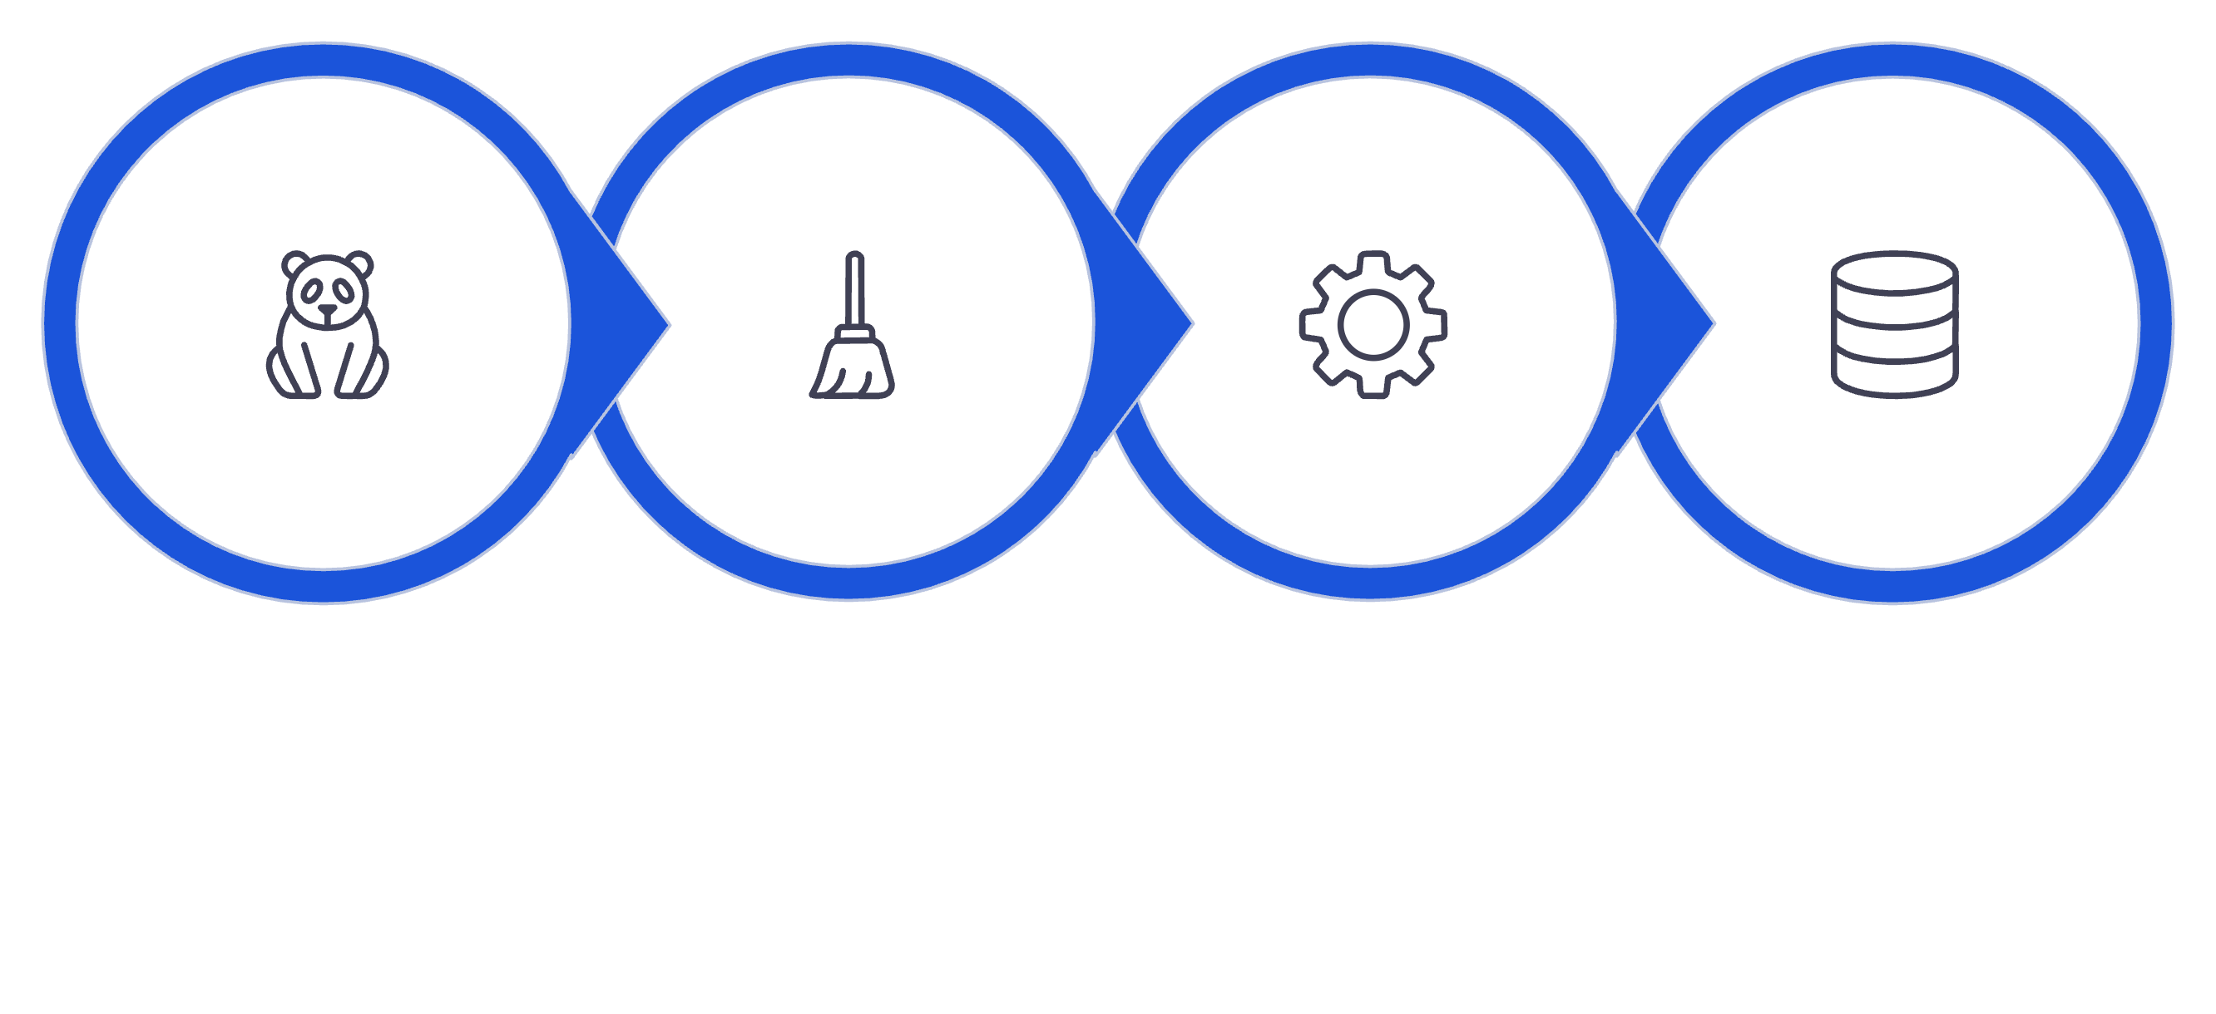
Python Data Preparation
Load & Explore
Clean & Standardize
Feature Engineer
Load to PostgreSQL
Columns were renamed to snake_case for readability. promo_code_used was dropped after confirming redundancy with discount_applied. The cleaned DataFrame was then loaded into PostgreSQL for SQL analysis.

Slide 4
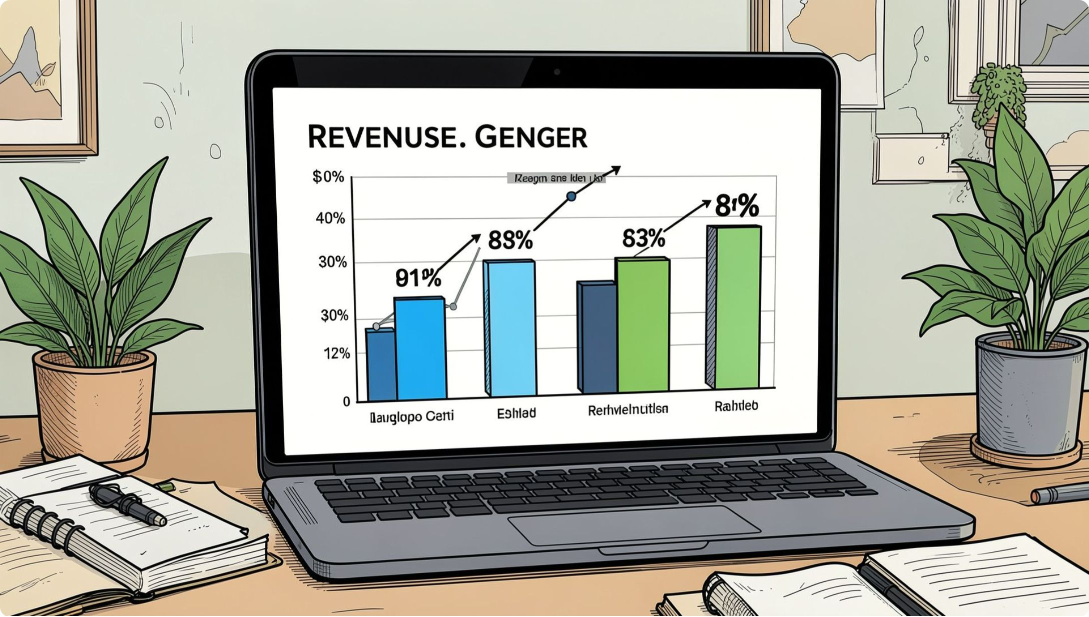
SQL Analysis: Revenue & Shipping
Revenue by Gender
Compared total revenue generated by male vs. female customers to identify purchasing power differences.
Shipping Type Comparison
Compared average purchase amounts between Standard and Express shipping to assess spending behavior.
High-Spending Discount Users
Identified customers who used discounts but still spent above the average purchase amount.

Slide 5
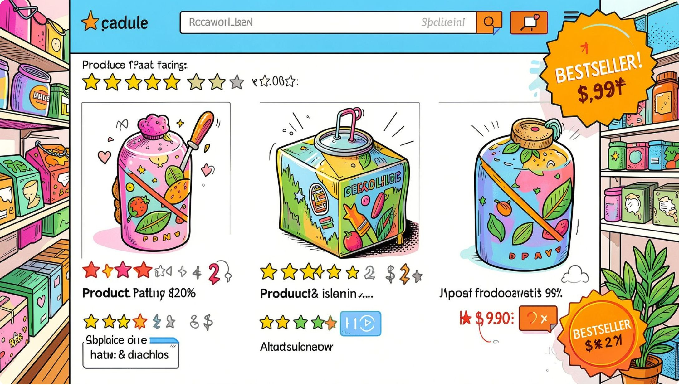
Top Products & Discount Patterns
Top 5 Products by Rating
Found products with the highest average review ratings to guide product positioning.
Discount-Dependent Products
Identified the 5 products with the highest percentage of discounted purchases to evaluate discount policy impact.
Top 3 Products per Category
Listed the most purchased products within each category to inform campaign priorities.

Slide 6
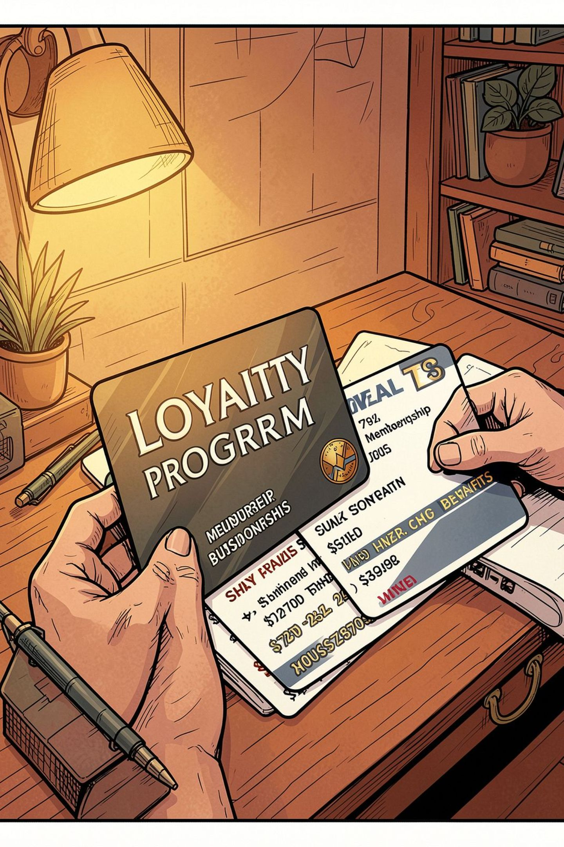
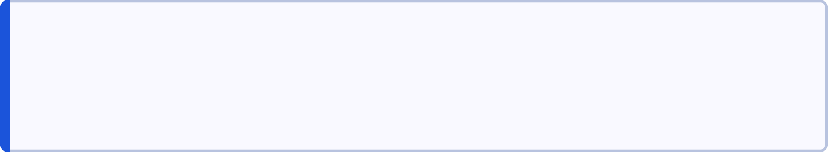
Subscribers vs. Non-Subscribers
Compared average spend and total revenue across subscription status, revealing meaningful differences in purchasing behavior between subscriber and non-subscriber groups.
Average Spend
Subscribers showed higher average purchase amounts compared to non-subscribers.
Total Revenue
Revenue contribution was compared across subscription status to assess segment value.
Repeat Buyers
Customers with more than 5 purchases were analyzed to determine if they are more likely to subscribe.

Slide 7
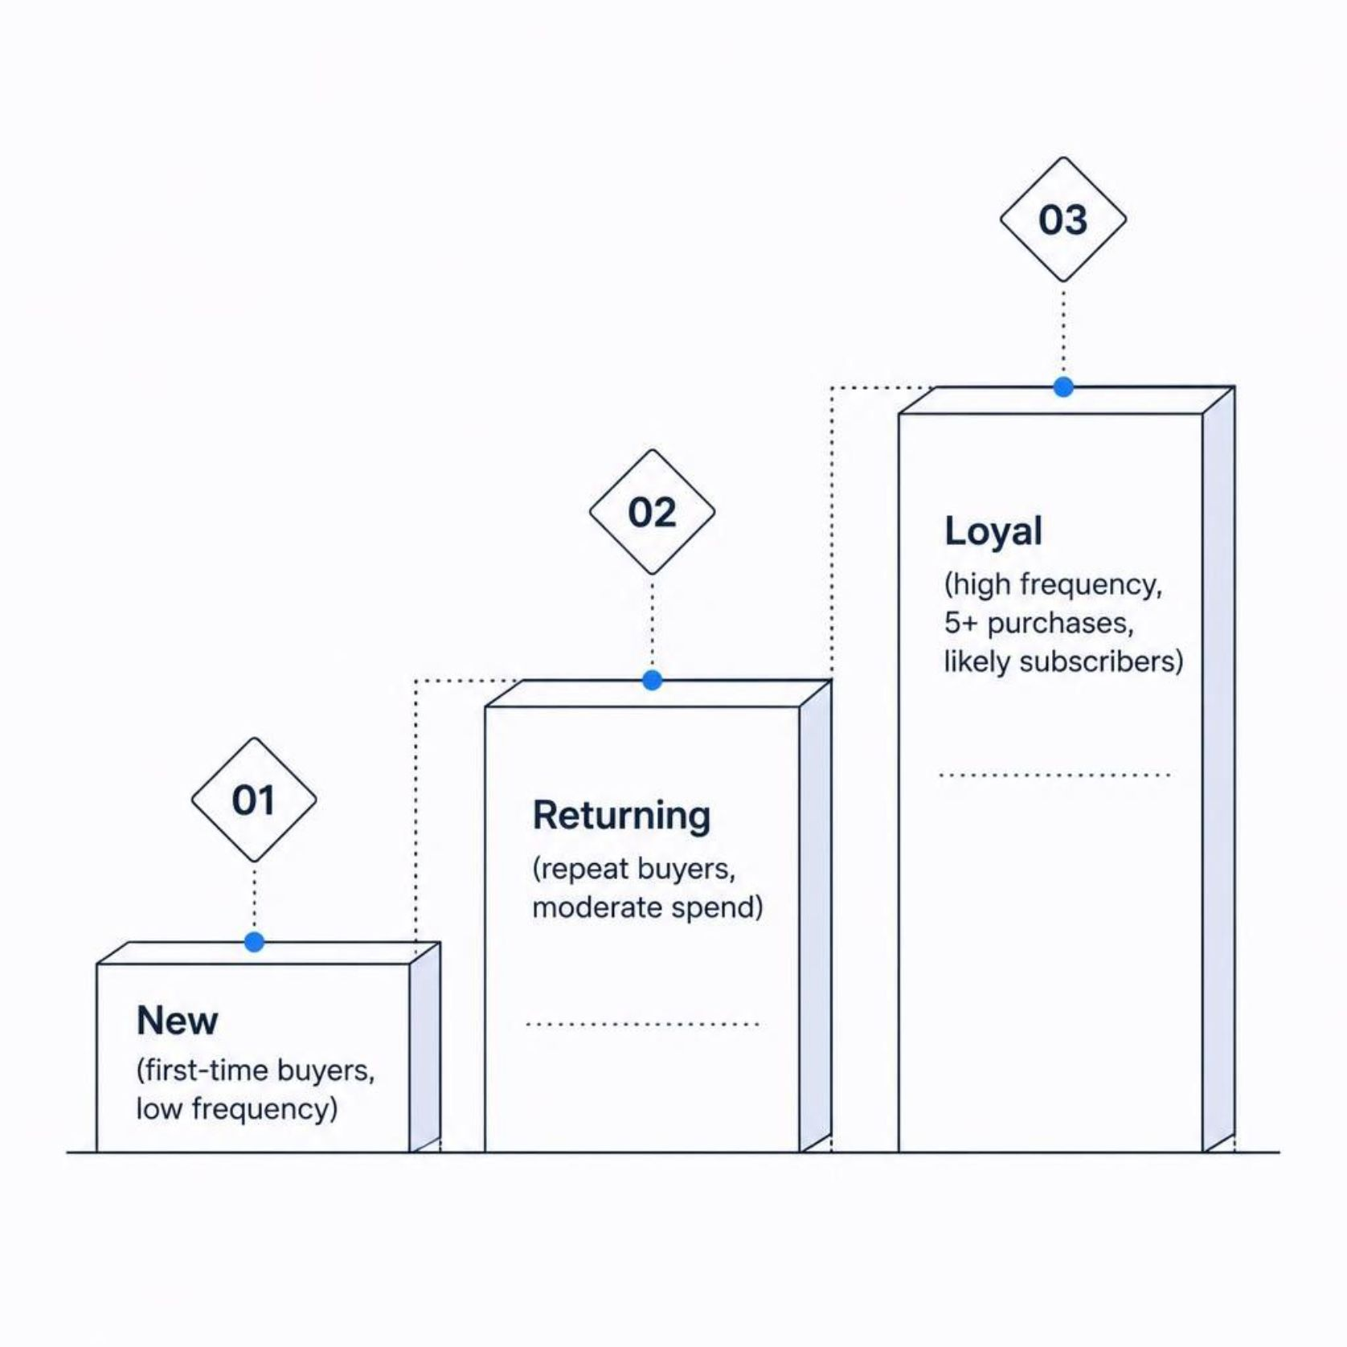
Customer Segmentation
Segmentation Logic
Customers were classified into New, Returning, and Loyal segments based on purchase history and frequency.
New: First-time or infrequent buyers
Returning: Repeat buyers with moderate spend
Loyal: 5+ purchases, high engagement, subscription-prone
Repeat buyers with more than 5 purchases were specifically analyzed to confirm their higher likelihood of subscribing.

Slide 8
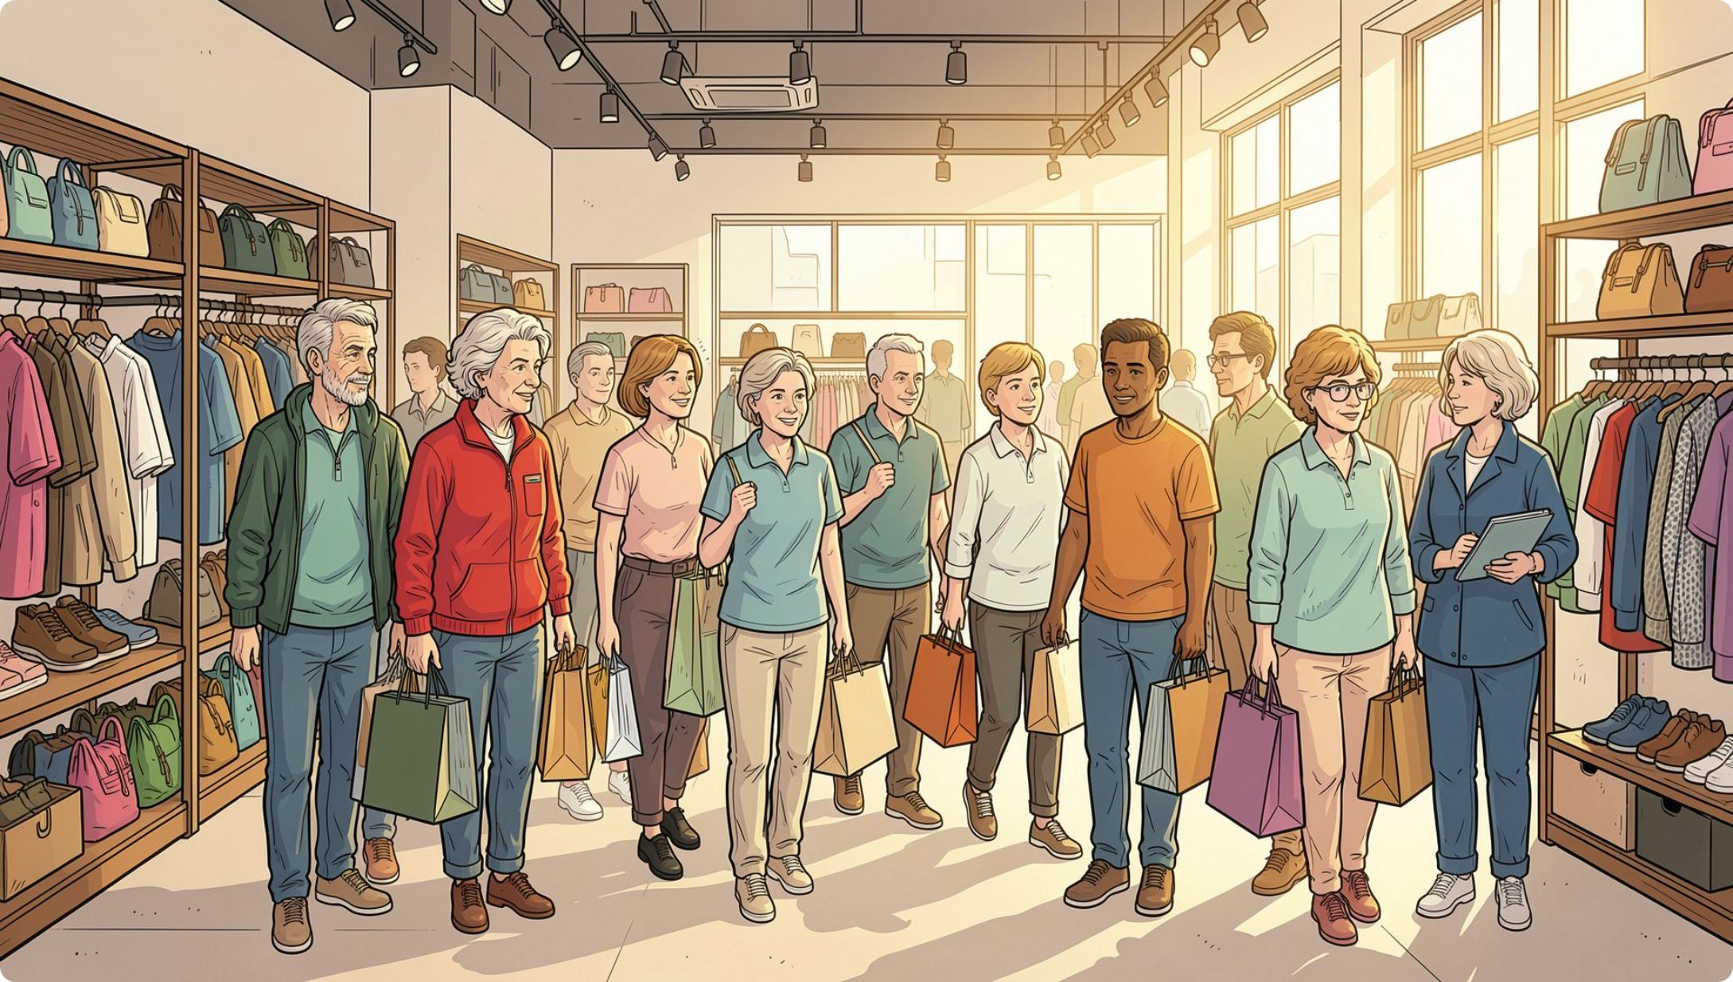

Revenue by Age Group
Age-Based Revenue Contribution
Total revenue was calculated for each age group by binning customer ages into segments. This analysis identifies which age demographics drive the most revenue, enabling targeted marketing toward high-revenue age groups and express-shipping users.
Age group segmentation was created as a new feature column (age_group) during the Python feature engineering step.

Slide 9
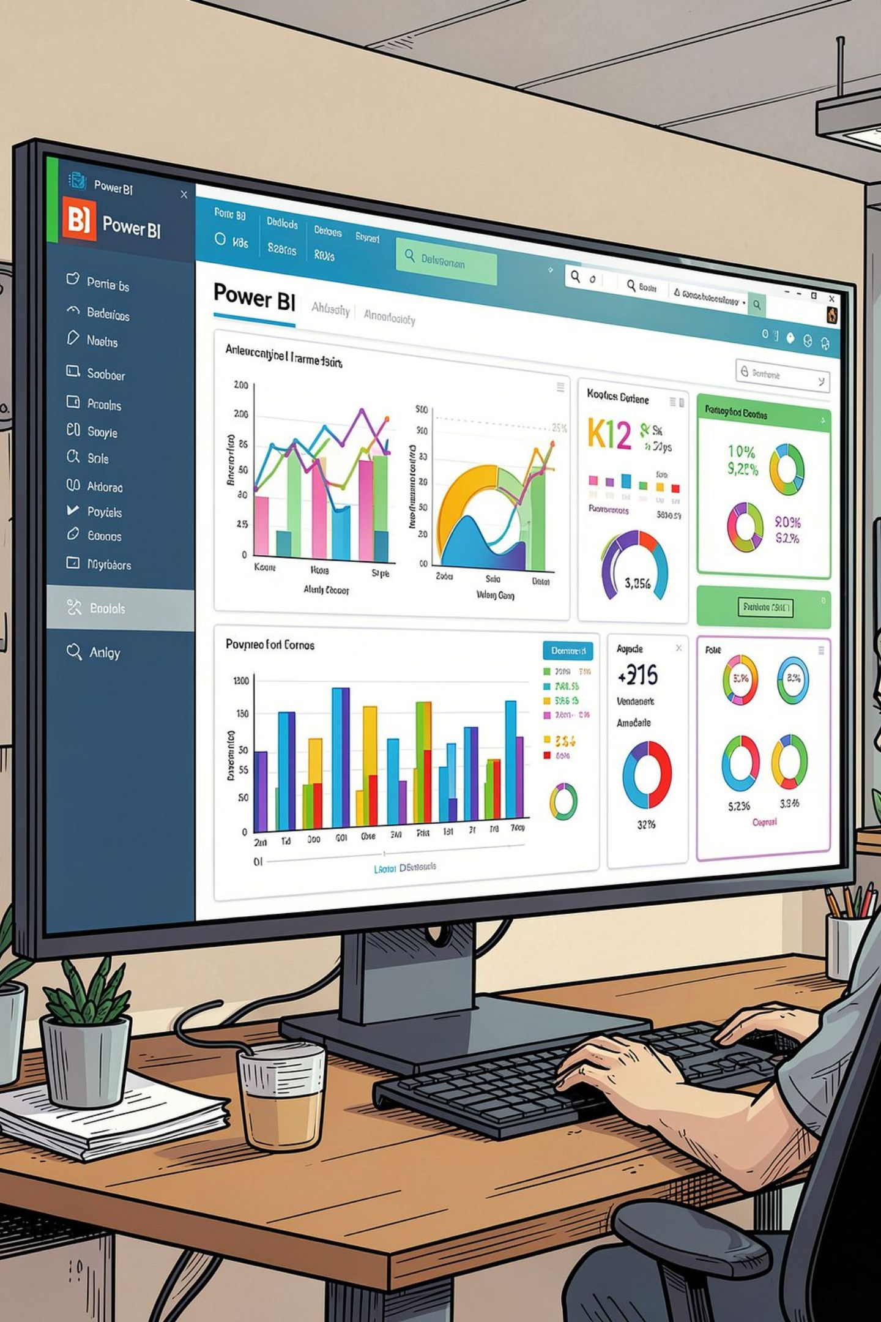
Power BI Dashboard
An interactive dashboard was built in Power BI to present all key insights visually — enabling stakeholders to explore revenue, segmentation, product performance, and subscription trends at a glance.

Slide 10





Business Recommendations
Boost Subscriptions
Loyalty Programs
Review Discount Policy
Promote exclusive benefits to convert repeat buyers into subscribers.
Reward repeat buyers to move them into the "Loyal" segment.
Balance sales boosts with margin control on discount-dependent products.
Targeted Marketing
Product Positioning
Focus on high-revenue age groups and express-shipping users.
Highlight top-rated and best-selling products in campaigns.

